Slide 1
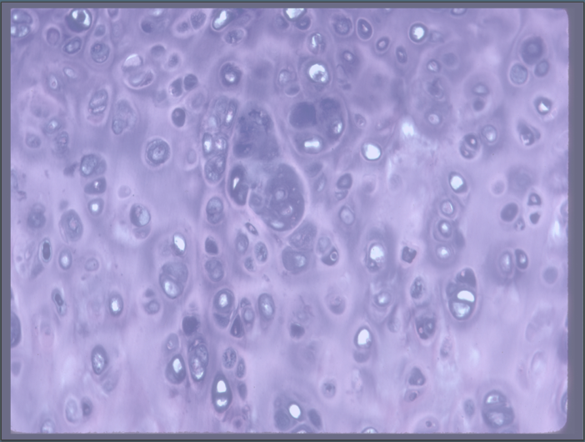
Epithelia Cells

Slide 2
Objectives
Define Epithelia Cells
Identify the location of Epithelia Cells
Classify types of Epithelia Cells

Slide 3
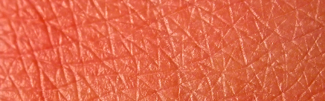
Epithelial Tissues
Epithelial tissues cover body surfaces.
  Outer layer of skin and the lining of organs
  Also found in glandular tissue
  Play roles in absorption, filtration, secretion, and protection against foreign substances

Slide 4
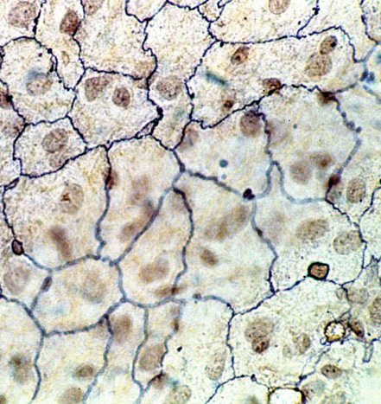
Special Characteristics of Epithelium
Usually fit closely together in continuous sheets
  Exception: glandular epithelium
Avascular (Have no blood supply of their own)
  How do they get nutrients?
If well nourished, epithelial cells regenerate themselves easily.
Notes:
Depend on the diffusion from the capillaries in the underlying connective tissue for food and oxygen.

Slide 5
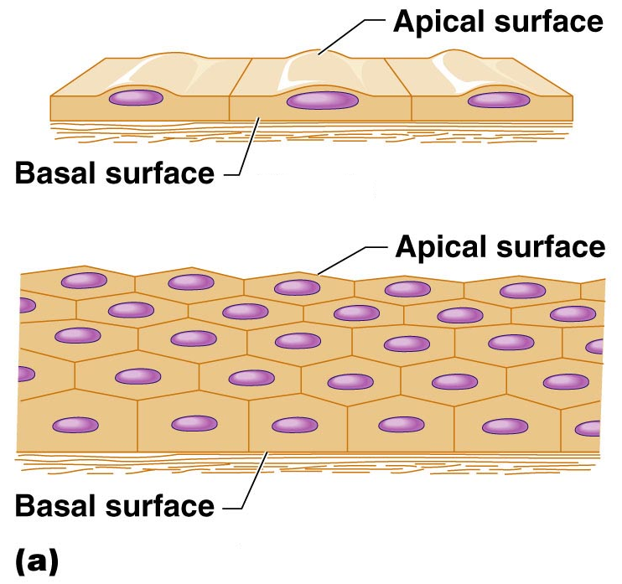
Special Characteristics of Epithelium
Have one free (unattached) surface or edge called the apical surface
  Exposed to body’s exterior or to the cavity of an internal organ
Lower surface of an epithelium rests on a basement membrane
  Structureless material secreted by both the epithelial cells and the connective tissue cells

Slide 6
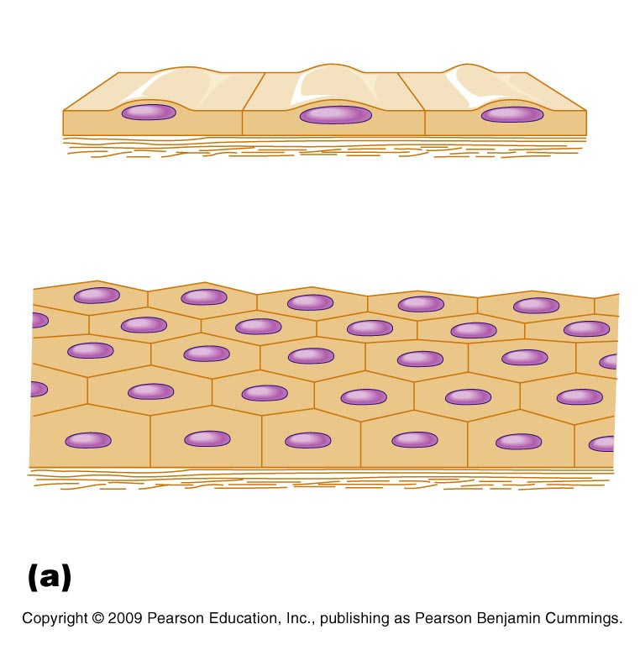


Classification of Epithelium
Each epithelium is given 2 names
First: indicates relative number of cell layers
  Simple (one layer of cells)
  Stratified (more than one cell layer)
Notes:
Squamous- cells flattened like scales, cuboidal- cube-shaped, columnar- shaped like columns

Slide 7
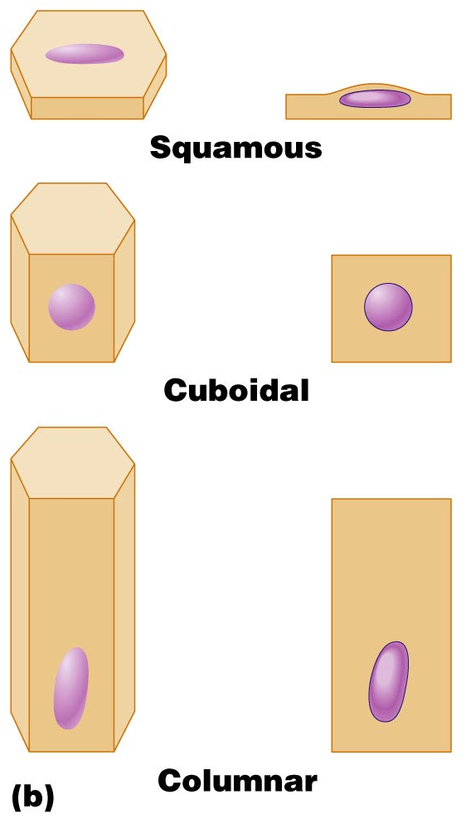
Classification of Epithelium
Second: describes the shape of cells
  Squamous (cells flattened like scales)
  Cuboidal (cube-shaped)
  Columnar (shaped like columns)
Notes:
Squamous- cells flattened like scales, cuboidal- cube-shaped, columnar- shaped like columns

Slide 8
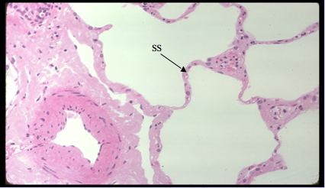
Simple Squamous Epithelium
Simple squamous (SS) tissue is composed of flat, scale-like cells that usually forms membranes
It lines the walls of blood vessels, pulmonary alveoli (shown here), and the lining of the heart, lung, and peritoneal cavities.

Slide 9
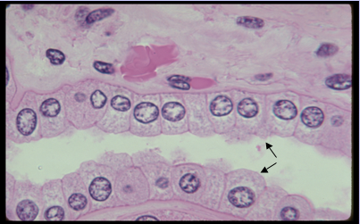
Simple Cuboidal Epithelium
This tissue is composed of a single layer of cube-like cells.
It lines the walls of kidney tubules, covers the surface of ovaries, and is common in glands and their ducts.

Slide 10
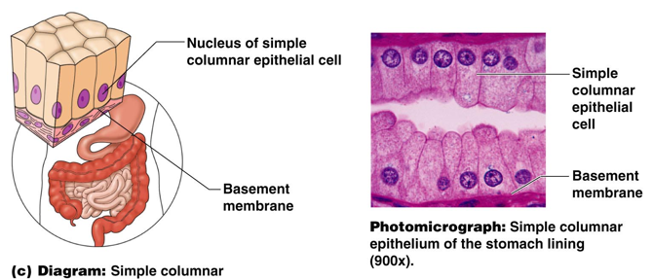
Simple Columnar Epithelium
This tissue is composed of a single layer of tall cells.
It often includes mucus-producing goblet cells.
It often lines the digestive tract.

Slide 11
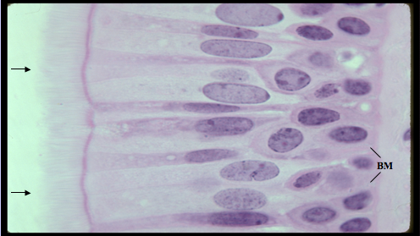
Pseudostratified Columnar Epithelium
Although this tissue appears stratified, it is actually composed of a single layer of cells of different types.
Although their nuclei are found at different levels, each cell adjoins the basal membrane (BM).
This tissue lines the larger respiratory passageways.
It is often ciliated (arrows).

Slide 12
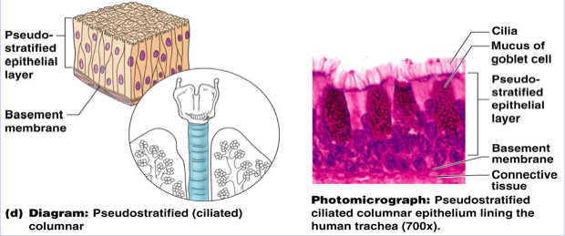
Pseudostratified Columnar Epithelium
Main functions: absorption and secretion
Ciliated variety lines respiratory tract
  Mucus produced by goblet cells traps dust and other debris
  Cilia propel mucus upward and away from the lungs

Slide 13
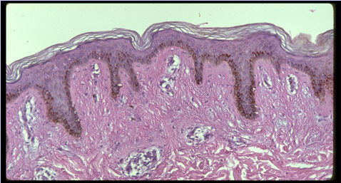
Stratified Squamous Epithelium
The term “stratified” refers to the layered arrangement of cells.
The outer layers of cells appear flat, but the inner cells vary in shape from cuboidal to columnar.
Stratified squamous epithelium serves as a barrier to the outside environment in locations such as the skin, mouth, and esophagus.

Slide 14
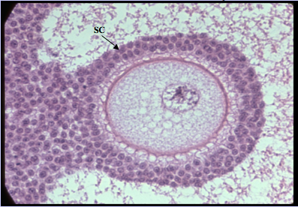
Stratified Cuboidal Epithelium
Stratified cuboidal epithelium (SC) is found in the ducts of sweat glands and surrounds Graafian follicles of ovaries (shown below).

Slide 15
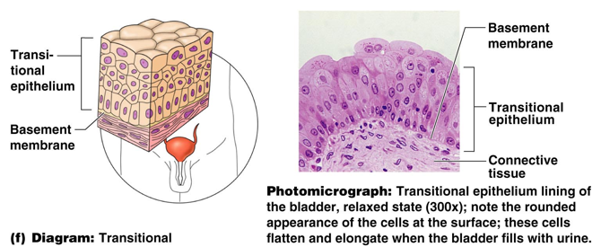
Transitional Epithelium
Shape of cells depends upon the amount of stretching
It lines organs of the urinary system.

Slide 16
Ciliated Epithelium
Some epithelial membranes are made up of cells with cilia, tiny projections that beat in unison to move mucus along the surface.
Ciliated epithelia in the trachea, for example, sweep debris out of the respiratory tract.

Slide 17
Glandular Epithelium
A gland is defined as one or more cells responsible for secreting a particular product
Two major gland types
  Endocrine gland
    Ductless since secretions diffuse into blood vessels
    All secretions are hormones
    Examples include pituitary, pancreas, ovaries, testes
  Exocrine gland
    Secretions empty through ducts to the epithelial surface
    Include sweat and oil glands

Slide 18
Objectives
Define Epithelia Cells
Identify the location of Epithelia Cells
Classify types of Epithelia Cells

